Slide 1
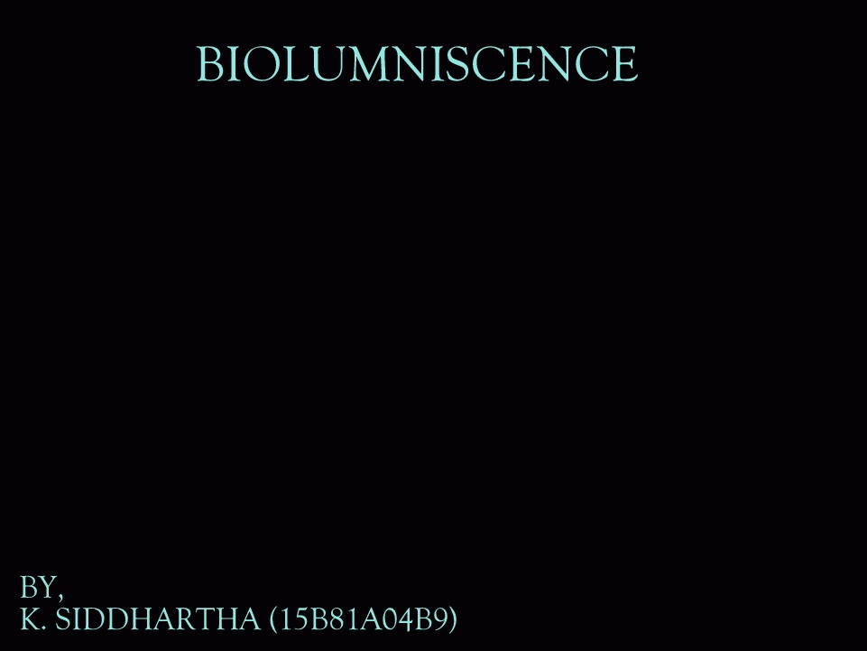


Slide 2
OVERVIEW
INTRODUCTION
MOTIVATION
HISTORY
GENETIC ENGINEERING
CHEMICAL REACTION
APPLICATIONS
ADVANTAGES
LIMITATIONS
CONCLUSION
REFERENCES

Slide 3

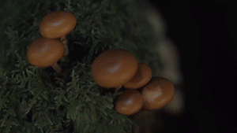
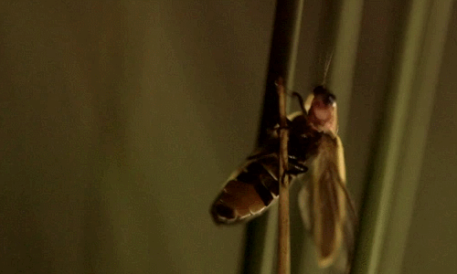
INTRODUCTION
Bioluminescence is a chemical reaction that takes place in an organism and produces detectable light.
This chemical process is different from fluorescence.
Eighty percent of all bioluminescent groups live in the world’s oceans, from the shallows to the deep sea floor.
Less frequently, bioluminescence also occurs on land, ranging from fireflies flashing in the grass to mushrooms in dark woods and glowworms shimmering in caves.

Slide 4
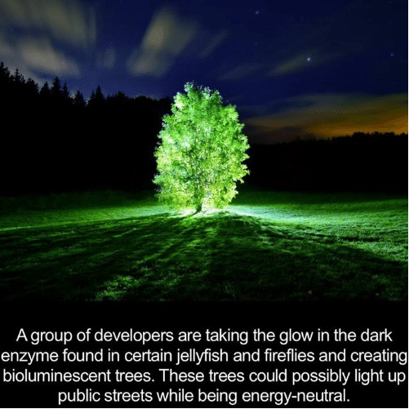
MOTIVATION

Slide 5
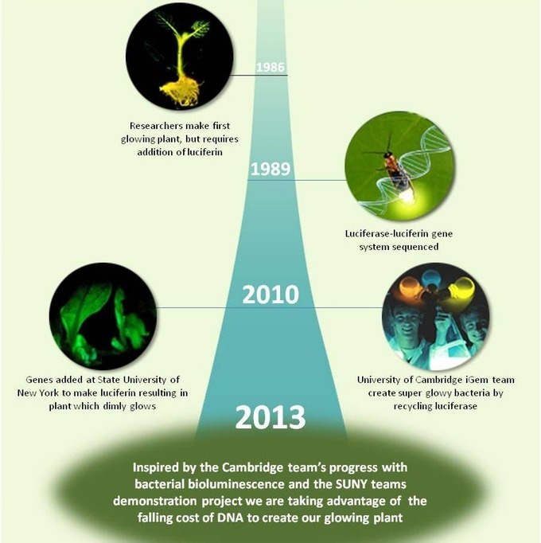
HISTORY

Slide 6
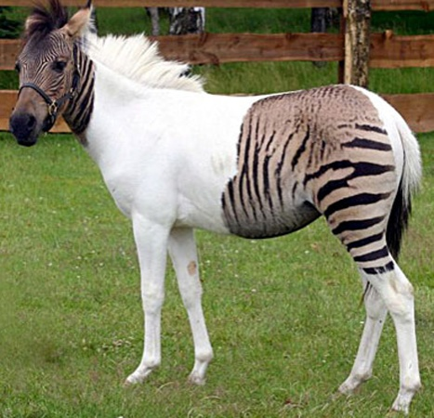
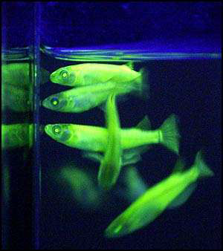
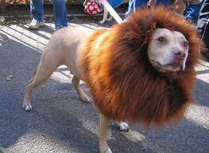
GENETIC ENGINEERING
Genetic Engineering is manipulation/alteration of structure of a gene to create a desired characteristic in an organism.
If genetic material from another species is added to the host, the resulting organism is called transgenic.
Some of the genetically modified crops are Bt Cotton, Bt Potato and various kinds of Mangos.
Not only crops but also genetically modified species are existing such as Glofish, Dolion and Zorse.

Slide 7
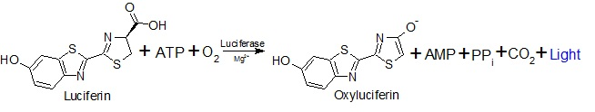
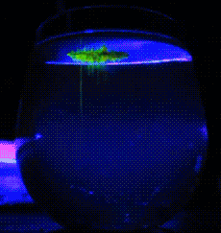
CHEMICAL REACTION

Slide 8
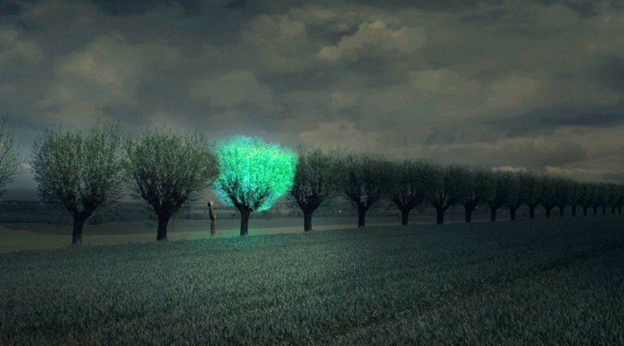
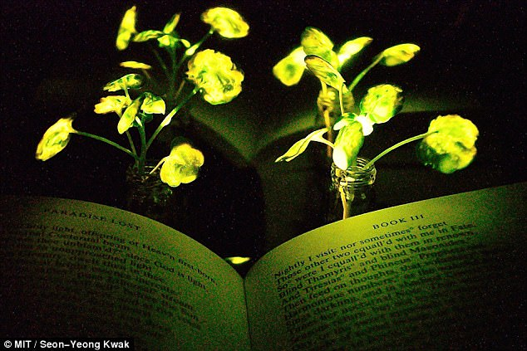

APPLICATIONS
Creating an energy neutral environment.
Alternate form of Green Energy.
Replacement of traditional street lights.
Enhancing living standards and preserving biodiversity.

Slide 9
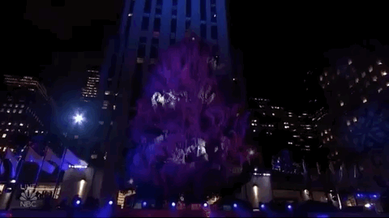
ADVANTAGES
Energy can be saved.
It provides scenic beauty.
It produces oxygen in the day.
It helps to reduce light pollution due to street lights in major cities.
Its mostly natural so cost of implementation will be very low.
It will reduce deforestation.

Slide 10
LIMITATIONS
Intensity of the light produced is very low.
Genetic Structure of each and every plant should be modified.
Lot of insects and flies are attracted to such lights.
Controlling or switching of the light is difficult.
Color of the light is mostly blue or green.

Slide 11

CONCLUSION
We are cutting down trees to facilitate ourselves but now we can engineer them in a way that they are beneficial and also can be adjusted with our urban lifestyle.
We also get to accommodate nature in our society.
This idea also helps to reduce many of the main global problems due to deforestation.

Slide 12
REFERENCES
BIOLUMINESCENCE, The NATURE of the LIGHT by John Lee, The University of Georgia, 2017.
Bioluminescence: Living Lights, Lights for Living by Therese Wilson and J. Woodland Hastings.
The Genetic Creation of Bioluminescent Plants for Urban and Domestic Use by Alberto T. Estevez Massachusetts Institute of Technology, 2007.
Bioluminescence imaging in living organisms by David K Welsh and Steve A Kay

Slide 13
